Slide 1
Unit-2 Cloud Computing Fundamentals
Notes:
‹#›

Slide 2
UNIT - II Cloud Computing Fundamentals
Motivation for Cloud Computing
The Need for Cloud Computing
Defining & Definition of Cloud computing
Cloud Computing Is a Service
Cloud Computing Is a Platform
Principles of Cloud computing
Five Essential Characteristics
Four Cloud Deployment Models
Three service models
Notes:
‹#›

Slide 3
Motivation for Cloud Computing
Increase in the flexibility of storage
Easily recover the data
Easy access to the data
Secure and protected
No maintenance required
Notes:
‹#›

Slide 4
Need for Cloud Computing
Convenience &Reliability
Much easier to share a file
Not possible to loose data/file
Use strong password& pay attention to any privacy setting for cloud service that we use.
Notes:
‹#›

Slide 5
Defining & Definition of Cloud Computing
Cloud computing means storing and accessing data and programs over the Internet from a remote location or computer instead of our computer’s hard drive.
The formal definition of cloud computing comes from the National Institute of Standards and Technology (NIST): “Cloud computing is a model for enabling ubiquitous, convenient, on-demand network access to a shared pool of configurable computing resources (e.g., networks, servers, storage, applications, and services) that can be rapidly provisioned and released with minimal management effort or service provider interaction.
Notes:
‹#›

Slide 6
Cloud Computing Is a Service
Example :Flickr
First, Flickr allows us to easily access our images no matter where we are or what type of device we are using.
Second, Flickr lets us share the images.
Third, Flickr provides data security.
Notes:
‹#›

Slide 7
Cloud Computing Is a Platform
The term platform is that it is the support on which applications run or give results to the users.
For example, Microsoft Windows is a platform. But, a platform does not have to be an operating system.
Java is a platform even though it is not an operating system.
Through cloud computing, the web is becoming a platform.
Notes:
‹#›

Slide 8
5-4-3 Principles of Cloud Computing
(a) The five essential characteristic features that promote cloud computing.
(b) The four deployment models that are used to narrate the cloud computing opportunities for customers while looking at architectural models.
(c) The three important and basic service offering models of cloud computing.
Notes:
‹#›

Slide 9
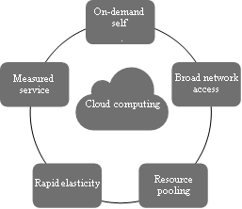
5.Essential Characteristics
On-demand self-service
Broad network access
Elastic resource pooling
Rapid elasticity
Measured service
Notes:
‹#›

Slide 10
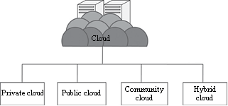
4.Deployment Models
Four deployment models are usually distinguished namely:
Public Cloud
Private Cloud
Community Cloud
Hybrid Cloud
Notes:
‹#›

Slide 11
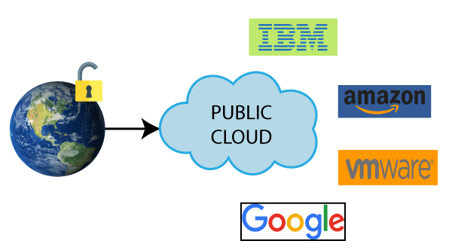
Public Cloud
Public Cloud: A Cloud facility which is deployed at vendors place and the cloud can be shared with multiple clients. The Services can be free or paid.
Example:GMAIL,FACEBOOK,DROPBOX,INSTAGRAM, are free and they are public clouds
Notes:
‹#›

Slide 12
Provides a shared platform that is accessible to the general public through an Internet connection.
It is operated on the pay-as-per-use model and administrated by the third party, i.e., Cloud service provider.
The same storage is being used by multiple users at the same time.
Public cloud is owned, managed, and operated by businesses, universities, government organizations, or a combination of them.
Amazon Elastic Compute Cloud (EC2), Microsoft Azure, IBM's Blue Cloud, Sun Cloud, and Google Cloud are examples of the public cloud.
Notes:
‹#›

Slide 13
Characteristics
Highly scalable
Affordable
Less secure
Highly available
Stringent SLAs
Suitability
The requirement for resources is large, that is, there is large user base.
The requirement for resources is varying.
There is no physical infrastructure available.
An organization has financial constraints
Non Suitability
• Security is very important.
• Organization expects autonomy.
• Third-party reliability is not preferred.
Issues
1.SLA
2.Network
3.Performance
4.Multitenancy
5.Location
6. Security and data privacy
7. Laws and conflicts
8. Cloud management
9. Maintenance

Slide 14
Advantages of Public Cloud
1) Low Cost :
shares the same resources with a large number of consumers.
2) Location Independent :
Its services are offered through the internet.
3) Save Time:
In Public cloud, the cloud service provider is responsible for the manage and maintain data centers in which data is stored, so the cloud user can save their time to establish connectivity, deploying new products, release product updates, configure, and assemble servers.
Notes:
‹#›

Slide 15
Advantages of Public Cloud
4) Quickly and easily set up:
Organizations can easily buy public cloud on the internet and deployed and configured it remotely through the cloud service provider within a few hours.
5) Business Agility:
Public cloud provides an ability to elastically re-size computer resources based on the organization's requirements
6) Scalability and reliability:
Public cloud offers scalable (easy to add and remove) and reliable (24*7 available) services to the users at an affordable cost.
Notes:
‹#›

Slide 16
Disadvantages of Public Cloud
Low Security:
Public Cloud is less secure because resources are shared publicly.
2) Performance:
In the public cloud, performance depends upon the speed of internet connectivity.
3) Less customizable:
Public cloud is less customizable than the private cloud.
Notes:
‹#›

Slide 17
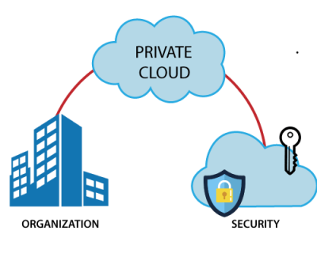
Private Cloud
Private Cloud:A cloud facility deployed at clients premises(on premises) and dedicated resources are allotted such cloud is called private cloud
Notes:
‹#›

Slide 18
Also known as an internal cloud or corporate cloud.
Provides computing services to a private internal network (within the organization) and selected users instead of the general public.
Provides a high level of security and privacy to data through firewalls and internal hosting
HP Data Centers, Microsoft, Elastra-private cloud, and Ubuntu are the example of a private cloud.
Notes:
‹#›

Slide 19
Characteristics
Secure
Central control
Weak
Suitability
The organizations or enterprises that require a separate cloud for their personal or official use.
• The organizations or enterprises that have a sufficient amount of funds as managing and maintaining a cloud is a costly affair.
• The organizations or enterprises that consider data security to be important.
• The organizations that want autonomy and complete control over the cloud.
• The organizations that have a less number of users.
• The organizations that have prebuilt infrastructure for deploying the cloud and are ready for timely maintenance of the cloud for efficient functioning.
• Special care needs to be taken and resources should be available for troubleshooting.
Non Suitability
The organizations that have high user base
• The organizations that have financial constraints
• The organizations that do not have prebuilt infrastructure
• The organizations that do not have sufficient manpower to maintain and manage the cloud

Slide 20
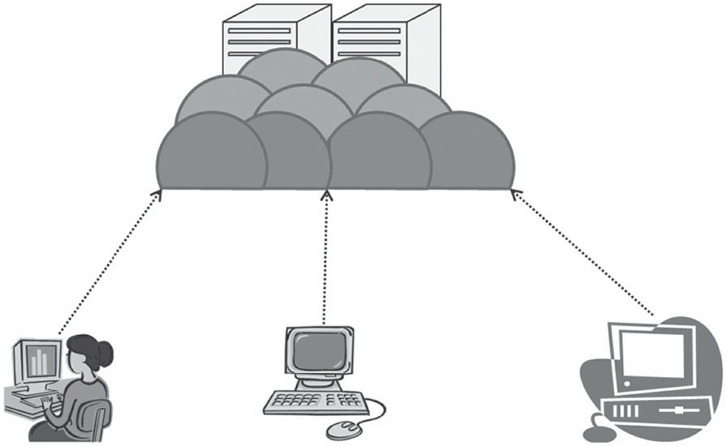
According to NIST [4], the private cloud can be classified into several types based on their location and management
On-premise private cloud
• Outsourced private cloud
On-Premise Private Cloud :It is a typical private cloud that is managed by a single organization. Here, the cloud is deployed in organizational premises and is connected to the organizational network
Issues
1.SLA
2.Network
3.Performance
4.Multitenancy
5.Location
6. Security and data privacy
7. Laws and conflicts
8. Cloud management
9. Maintenance User 1 User 2 User 3
Cloud

Slide 21
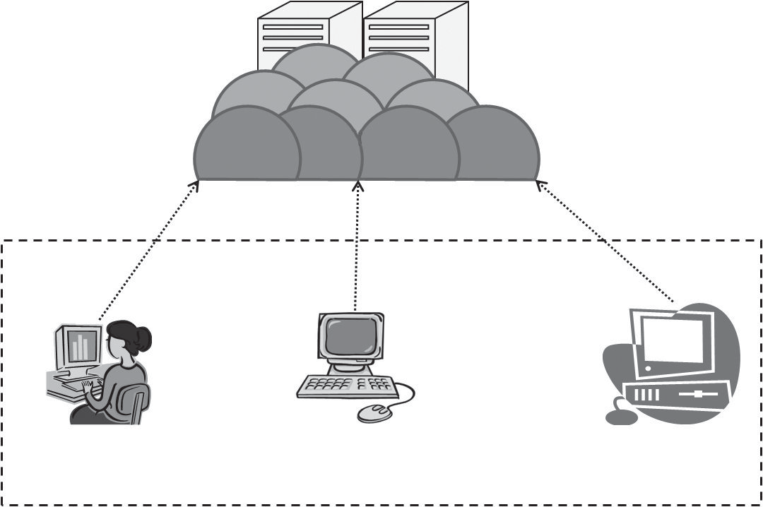
Outsourced Private Cloud :It has a cloud outsourced to a third party. A third party manages the whole cloud. Everything is same as usual private cloud except that here the cloud is outsourced
Issues
1.SLA
2.Network
3.Performance
4.Location
5. Security and data privacy
6. Laws and conflicts
7. Cloud management
8. Maintenance
Cloud
User 1
User 2
Private organization
User 3

Slide 22
Advantages of Private Cloud
1) More Control:
more control over their resources and hardware than public clouds because it is only accessed by selected users.
2) Security & privacy:
Security & privacy are one of the big advantages of cloud computing. Private cloud improved the security level as compared to the public cloud
3) Improved performance:
Private cloud offers better performance with improved speed and space capacity.
Notes:
‹#›

Slide 23
Disadvantages of Private Cloud
1) High cost:
The cost is higher than a public cloud because set up and maintain hardware resources are costly.
2) Restricted area of operations:
Private cloud is accessible within the organization, so the area of operations is limited.
3) Limited scalability:
Private clouds are scaled only within the capacity of internal hosted resources.
4) Skilled people:
Skilled people are required to manage and operate cloud services.
Notes:
‹#›

Slide 24
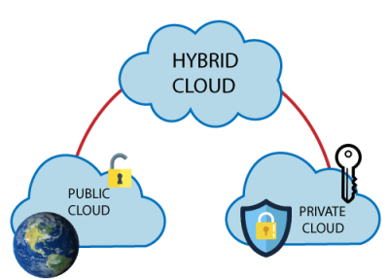
Hybrid Cloud
Hybrid Cloud: it’s a combination of any above cloud facility. Hybrid cloud is a combination of public and private clouds.
Hybrid cloud = public cloud + private cloud.
Eg : Ctrl+S it is a company which offers backup and recovery services
MEGHDOOT(private)+Ctrl+S(public)=Hybrid Cloud
Notes:
‹#›

Slide 25
The main aim to combine these cloud (Public and Private) is to create a unified, automated, and well-managed computing environment.
In the Hybrid cloud, non-critical activities are performed by the public cloud and critical activities are performed by the private cloud.
A hybrid cloud is used in finance, healthcare, and Universities.
The best hybrid cloud provider companies are Amazon, Microsoft, Google, Cisco, and NetApp.
Notes:
‹#›

Slide 26
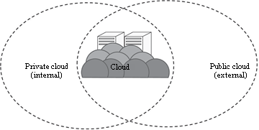
characteristics
Scalable
Partially secure
Stringent SLAs
Complex cloud management
Suitability
• Organizations that want the private cloud environment with the scalability of the public cloud
• Organizations that require more security than the public cloud
Non Suitability
Organizations that consider security as a prime objective
Organizations that will not be able to handle hybrid cloud management
ISSUES
1.SLA
2.Network
3.Performance
4.Multitenancy
5.Location
6. Security and data privacy
7. Laws and conflicts
8. Cloud management
9. Maintenance

Slide 27
Advantages of Hybrid Cloud
1) Flexible and secure:
It provides flexible resources because of the public cloud and secure resources because of the private cloud.
2) Cost effective:
Hybrid cloud costs less than the private cloud.
3) Security:
Hybrid cloud is secure because critical activities are performed by the private cloud.
4) Risk Management:
Hybrid cloud provides an excellent way for companies to manage the risk.
Notes:
‹#›

Slide 28
Disadvantages of Hybrid Cloud
1) Networking issues :
Networking becomes complex because of the private and the public cloud.
2) Infrastructure Compatibility :
Infrastructure compatibility is the major issue in a hybrid cloud
3) Reliability :
The reliability of the services depends on cloud service providers.
Notes:
‹#›

Slide 29
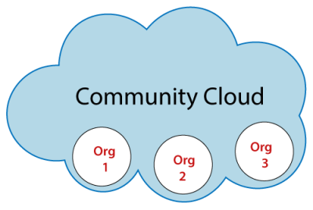
Community Cloud
It allows systems and services to be accessible by a group of several organizations to share the information.
It is owned, managed, and operated by one or more organizations in the community, a third party, or a combination of them.
Notes:
‹#›

Slide 30
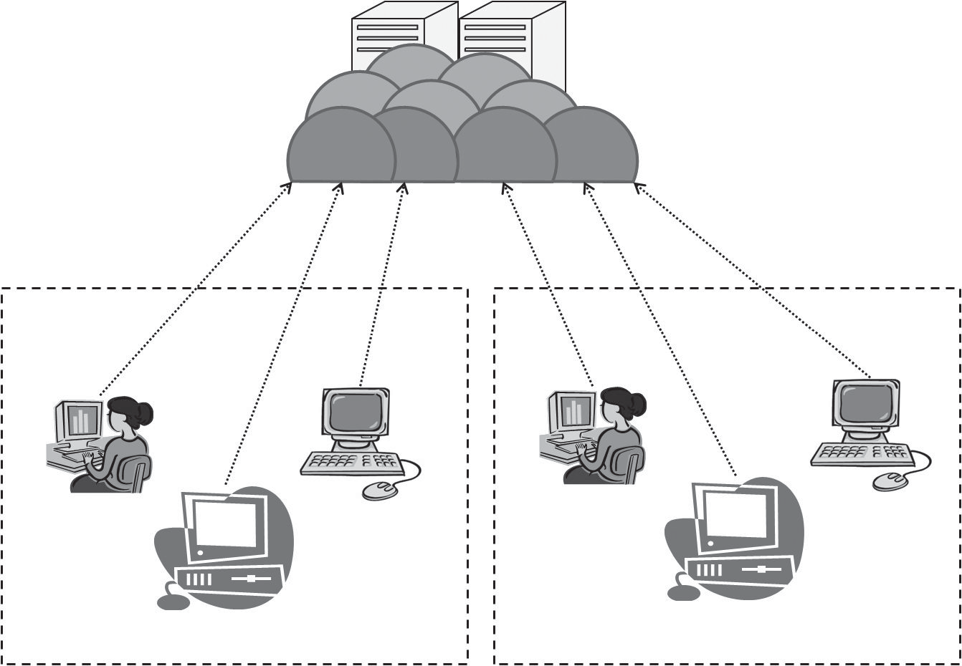
Characteristics
Collaborative and distributive maintenance
Partially secure
Cost effective
Suitability
This kind of cloud is suitable for organizations that
• Want to establish a private cloud but have financial constraint
• Do not want to complete maintenance responsibility of the cloud
• Want to establish the cloud in order to collaborate with other clouds
• Want to have a collaborative cloud with more security features than the public cloud.
Non Suitability
This cloud is not suitable for organizations that
• Prefer autonomy and control over the cloud
• Does not want to collaborate with other organizations
There are two types of community cloud deployments:
On-premise community cloud
2. Outsourced community cloud
Cloud
Private organization
Private organization
User 1
User 3
User 1
User 3
User 2
User 2

Slide 31
On-Premise Community Cloud :On-premise community cloud consists of the cloud deployed within the premises and is maintained by the organizations themselves
Issues
1.SLA
2.Network
3.Performance
4.Multitenancy
5.Location
6. Security and data privacy
7. Laws and conflicts
8. Cloud management
9. Maintenance
Outsourced Community Cloud In the outsourced community cloud, the cloud is outsourced to a third party. The third party is responsible for maintenance and management of the cloud
1.SLA
2.Network
3.Performance
4.Location
5. Security and data privacy
6. Laws and conflicts
7. Cloud management
8. Maintenance

Slide 32
Advantages of Community Cloud
1) Cost effective :
Community cloud is cost effective because the whole cloud is shared between several organizations or a community.
2) Flexible and Scalable :
The community cloud is flexible and scalable because it is compatible with every user.
3) Security :
Community cloud is more secure than the public cloud but less secure than the private cloud.
4) Sharing Infrastructure :
Community cloud allows us to share cloud resources, infrastructure, and other capabilities among various organizations.
Notes:
‹#›

Slide 33
Disadvantages of Community Cloud
Community cloud is not a good choice for every organization.
Slow adoption to data.
The fixed amount of data storage and bandwidth is shared among all community members.
Community Cloud is costly than the public cloud.
Sharing responsibilities among organizations is difficult.
Notes:
‹#›

Slide 34
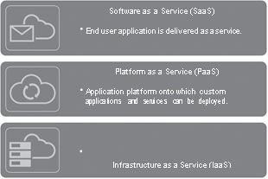
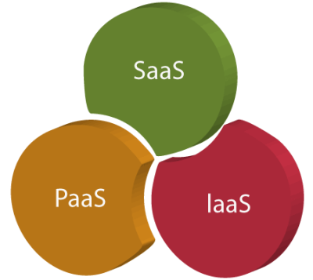
Service Models
Software as a Service (SaaS)
Platform as a Service (PaaS)
Infrastructure as a Service (IaaS)
Notes:
‹#›

Slide 35
Software as a Service (SaaS)
SaaS is also known as "On-Demand Software".
It is a software distribution model in which services are hosted by a cloud service provider.
These services are available to end-users over the internet so, the end-users do not need to install any software on their devices to access these services.
Notes:
‹#›

Slide 36
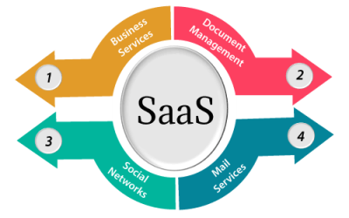
SaaS Services
1) Business Services :
SaaS Provider provides various business services to start-up the business. The SaaS business services include ERP (Enterprise Resource Planning), CRM (Customer Relationship Management), billing, and sales.
Notes:
‹#›

Slide 37
2) Document Management:
SaaS document management is a software application offered by a third party (SaaS providers) to create, manage, and track electronic documents.
Example: Slack, Samepage, Box, and Zoho Forms.
3) Social Networks:
As we all know, social networking sites are used by the general public, so social networking service providers use SaaS for their convenience and handle the general public's information.
4) Mail Services:
To handle the unpredictable number of users and load on
e-mail services, many e-mail providers offering their services using SaaS.
Notes:
‹#›

Slide 38
Advantages of SaaS
1) SaaS is easy to buy:
SaaS pricing is based on a monthly fee or annual fee subscription, so it allows organizations to access business functionality at a low cost, which is less than licensed applications.
2) One to Many:
SaaS services are offered as a one-to-many model means a single instance of the application is shared by multiple users.
3) Less hardware required for SaaS:
The software is hosted remotely, so organizations do not need to invest in additional hardware.
Notes:
‹#›

Slide 39
4) Low maintenance required for SaaS:
Software as a service removes the need for installation, set-up, and daily maintenance for the organizations. The initial set-up cost for SaaS is typically less than the enterprise software. SaaS vendors are pricing their applications based on some usage parameters, such as a number of users using the application. So SaaS does easy to monitor and automatic updates
5) No special software or hardware versions required:
All users will have the same version of the software and typically access it through the web browser. SaaS reduces IT support costs by outsourcing hardware and software maintenance and support to the IaaS provider.
Notes:
‹#›

Slide 40
6) Multidevice Support:
SaaS services can be accessed from any device such as desktops, laptops, tablets, phones, and thin clients.
7) API Integration:
SaaS services easily integrate with other software or services through standard APIs.
8) No client-side installation:
SaaS services are accessed directly from the service provider using the internet connection, so do not need to require any software installation.
.
Notes:
‹#›

Slide 41
Disadvantages of SaaS
1) Security:
Actually, data is stored in the cloud, so security may be an issue for some users. However, cloud computing is not more secure than in-house deployment.
2) Latency issue:
Since data and applications are stored in the cloud at a variable distance from the end-user, there is a possibility that there may be greater latency when interacting with the application compared to local deployment. Therefore, the SaaS model is not suitable for applications whose demand response time is in milliseconds.
Notes:
‹#›

Slide 42
3) Total Dependency on Internet
Without an internet connection, most SaaS applications are not usable.
4) Switching between SaaS vendors is difficult
Switching SaaS vendors involves the difficult and slow task of transferring the very large data files over the internet and then converting and importing them into another SaaS also.
Notes:
‹#›

Slide 43
Popular SaaS providers
Provider | Services
Salseforce.com | On-demand CRM solutions
Microsoft Office 365 | Online office suite
Google Apps | Gmail, Google Calendar, Docs, and sites
NetSuite | ERP, accounting, order management, CRM, Professionals Services Automation (PSA), and e-commerce applications.
GoToMeeting | Online meeting and video-conferencing software
Constant Contact | E-mail marketing, online survey, and event marketing
Oracle CRM | CRM applications
Workday, Inc | Human capital management, payroll, and financial management.
Notes:
‹#›

Slide 44
Platform as a Service ( PaaS)
Platform as a Service (PaaS) provides a runtime environment.
It allows programmers to easily create, test, run, and deploy web applications. You can purchase these applications from a cloud service provider on a pay-as-per use basis and access them using the Internet connection.
In PaaS, back end scalability is managed by the cloud service provider, so end- users do not need to worry about managing the infrastructure.
PaaS includes infrastructure (servers, storage, and networking) and platform (middleware, development tools, database management systems, business intelligence, and more) to support the web application life cycle.
Example: Google App Engine, Force.com, Joyent, Azure.
Notes:
‹#›

Slide 45
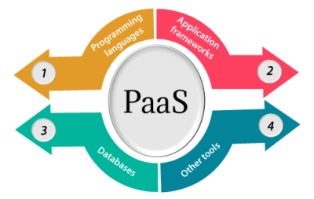
PaaS Providers
1. Programming languages:
PaaS providers provide various programming languages for the developers to develop the applications. Some popular programming languages provided by PaaS providers are Java, PHP, Ruby, Perl, and Go.
Notes:
‹#›

Slide 46
2. Application frameworks:
PaaS providers provide application frameworks to easily understand the application development. Some popular application frameworks provided by PaaS providers are Node.js, Drupal, Joomla, WordPress, Spring, Play, Rack, and Zend.
3. Databases:
PaaS providers provide various databases such as ClearDB, PostgreSQL, MongoDB, and Redis to communicate with the applications.
4. Other tools:
PaaS providers provide various other tools that are required to develop, test, and deploy the applications
Notes:
‹#›

Slide 47
Advantages of PaaS
1) Simplified Development:
PaaS allows developers to focus on development and innovation without worrying about infrastructure management.
2) Lower risk:
No need for up-front investment in hardware and software. Developers only need a PC and an internet connection to start building applications.
3) Prebuilt business functionality:
Some PaaS vendors also provide already defined business functionality so that users can avoid building everything from very scratch and hence can directly start the projects only.
Notes:
‹#›

Slide 48
4) Instant community:
PaaS vendors frequently provide online communities where the developer can get the ideas to share experiences and seek advice from others.
5) Scalability:
Applications deployed can scale from one to thousands of users without any changes to the applications
Notes:
‹#›

Slide 49
Disadvantages of PaaS
1) Vendor lock-in:
One has to write the applications according to the platform provided by the PaaS vendor, so the migration of an application to another PaaS vendor would be a problem.
2) Data Privacy:
Corporate data, whether it can be critical or not, will be private, so if it is not located within the walls of the company, there can be a risk in terms of privacy of data.
3) Integration with the rest of the systems applications:
It may happen that some applications are local, and some are in the cloud. So there will be chances of increased complexity when we want to use data which in the cloud with the local data
Notes:
‹#›

Slide 50
Popular PaaS Providers
Provider | Services
Google App Engine (GAE) | App Identity, URL Fetch, Cloud storage client library, Logservice
Salesforce.com | Faster implementation, Rapid scalability, CRM Services, Sales cloud, Mobile connectivity, Chatter.
Windows Azure | Compute, security, IoT, Data Storage.
AppFog | Justcloud.com, SkyDrive, GoogleDocs
Openshift | RedHat, Microsoft Azure.
Cloud Foundry from VMware | Data, Messaging, and other services
Notes:
‹#›

Slide 51
Infrastructure as a Service ( IaaS)
Iaas is also known as Hardware as a Service (HaaS). It is one of the layers of the cloud computing platform.
It allows customers to outsource their IT infrastructures such as servers, networking, processing, storage, virtual machines, and other resources.
Customers access these resources on the Internet using a pay-as-per use model.
IaaS is offered in three models: public, private, and hybrid cloud.
The private cloud implies that the infrastructure resides at the customer-premise. In the case of public cloud, it is located at the cloud computing platform vendor's data center, and the hybrid cloud is a combination of the two in which the customer selects the best of both public cloud or private cloud.
Notes:
‹#›

Slide 52
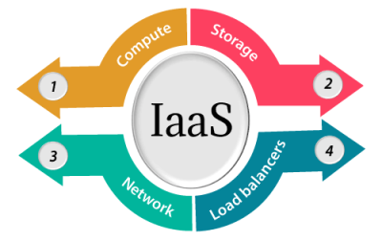
IaaS provider
1) Compute:
Computing as a Service includes virtual central processing units and virtual main memory for the Vms that is provisioned to the end- users.
Notes:
‹#›

Slide 53
2) Storage:
IaaS provider provides back-end storage for storing files.
3) Network:
Network as a Service (NaaS) provides networking components such as routers, switches, and bridges for the Vms.
4) Load balancers:
It provides load balancing capability at the infrastructure layer.
Notes:
‹#›

Slide 54
Advantages of IaaS
1. Shared infrastructure
IaaS allows multiple users to share the same physical infrastructure.
2. Web access to the resources
Iaas allows IT users to access resources over the internet.
3. Pay-as-per-use model
IaaS providers provide services based on the pay-as-per-use basis. The users are required to pay for what they have used
Notes:
‹#›

Slide 55
4) Focus on the core business:
IaaS providers focus on the organization's core business rather than on IT infrastructure.
5) On-demand scalability:
On-demand scalability is one of the biggest advantages of IaaS. Using IaaS, users do not worry about to upgrade software and troubleshoot the issues related to hardware components
Notes:
‹#›

Slide 56
Disadvantages of IaaS
1. Security:
Security is one of the biggest issues in IaaS. Most of the IaaS providers are not able to provide 100% security.
2. Maintenance & Upgrade:
Although IaaS service providers maintain the software, but they do not upgrade the software for some organizations.
3. Interoperability issues:
It is difficult to migrate VM from one IaaS provider to the other, so the customers might face problem related to vendor lock-in.
Notes:
‹#›

Slide 57
Iaas Providers
IaaS Vendor | Iaas Solution | Details
Amazon Web Services | Elastic, Elastic Compute Cloud (EC2) Map Reduce, Route 53, Virtual Private Cloud, etc. | The cloud computing platform pioneer, Amazon offers auto scaling, cloud monitoring, and load balancing features as part of its portfolio.
Netmagic Solutions | Net magic IaaS Cloud | Net magic runs from data centers in Mumbai, Chennai, and Bangalore, and a virtual data center in the United States. Plans are underway to extend services to West Asia.
Rackspace | Cloud servers, Cloud files, Cloud sites, etc. | The cloud computing platform vendor focuses primarily on enterprise-level hosting services.
Notes:
‹#›

Slide 58
IaaS Vendor | Iaas Solution | Details
Reliance Communications | Reliance Internet Data Center | RIDC supports both traditional hosting and cloud services, with data centers in Mumbai, Bangalore, Hyderabad, and Chennai. The cloud services offered by RIDC include IaaS and SaaS.
Sify Technologies | Sify IaaS | Sify's cloud computing platform is powered by HP's converged infrastructure. The vendor offers all three types of cloud services: IaaS, PaaS, and SaaS.
Tata Communications | InstaCompute | InstaCompute is Tata Communications' IaaS offering. InstaCompute data centers are located in Hyderabad and Singapore, with operations in both countries.
Notes:
‹#›

Slide 59
Difference between IaaS, PaaS, and SaaS
IaaS | PaaS | SaaS
It provides a virtual data center to store information and create platforms for app development, testing, and deployment. | It provides virtual platforms and tools to create, test, and deploy apps. | It provides web software and apps to complete business tasks.
It provides access to resources such as virtual machines, virtual storage, etc. | It provides runtime environments and deployment tools for applications. | It provides software as a service to the end-users.
It is used by network architects. | It is used by developers. | It is used by end users.
IaaS provides only Infrastructure. | PaaS provides Infrastructure+Platform. | SaaS provides Infrastructure+Platform +Software.
Notes:
‹#›

Slide 60
THANK YOU
Notes:
‹#›

